Slide 1
Session 3.3 CSS 3 Properties Lists, Box Model & Effects

Slide 2
Contents
CSS3 Lists Styling
CSS3 Box Model
CSS3 Margin & Padding
CSS3 Effects & Tables
CSS3 Image Gallery Demo

Slide 3
CSS Lists
Lists are by default numbered or bulleted
We can style lists by CSS
Properties:
list-style-image
list-style-position
list-style-type

Slide 4
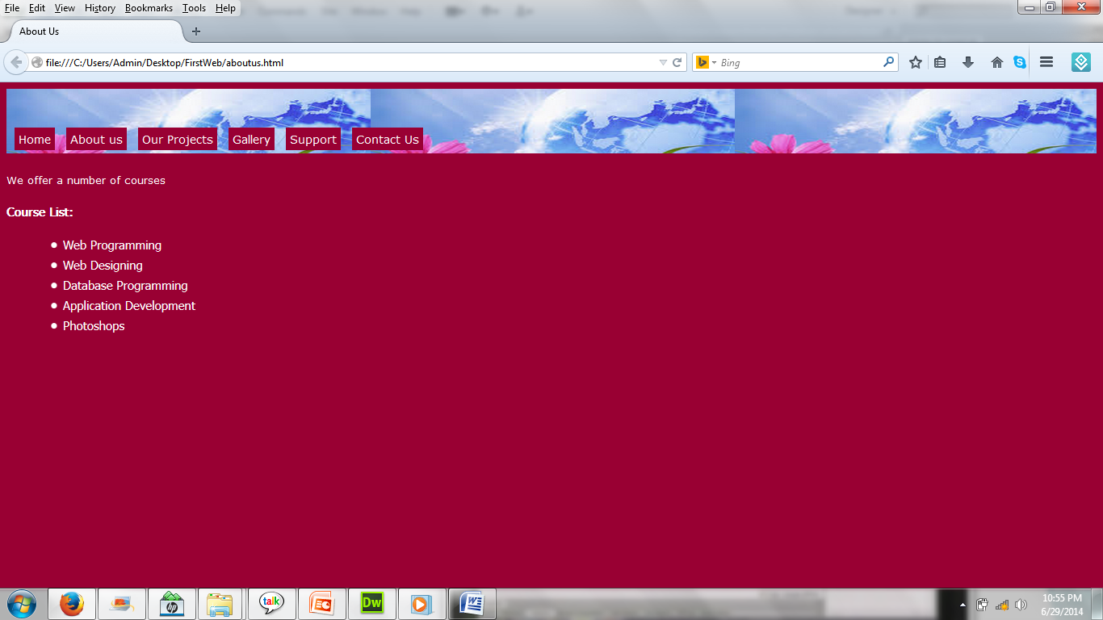
Lists with Bullets
Display Bullets

Slide 5
Lists with Bullets (HTML)
<div id="maincontent">
<p> We offer a number of courses</p>
<h3>Course List:</h3>
<ul class="lists">
<li>Web Programming</li>
<li>Web Designing</li>
<li>Database Programming</li>
<li>Application Development</li>
<li>Photoshops</li>
</ul>
</div>

Slide 6
Lists with Bullets (CSS)
.lists
{ color:#FFF;
font-size:15px;
list-style-type:disc;
margin-left:30px;}
#maincontent p
{ font-size::14px;}
#maincontent h3
{ font-size::18px;
color:#FFF; }

Slide 7
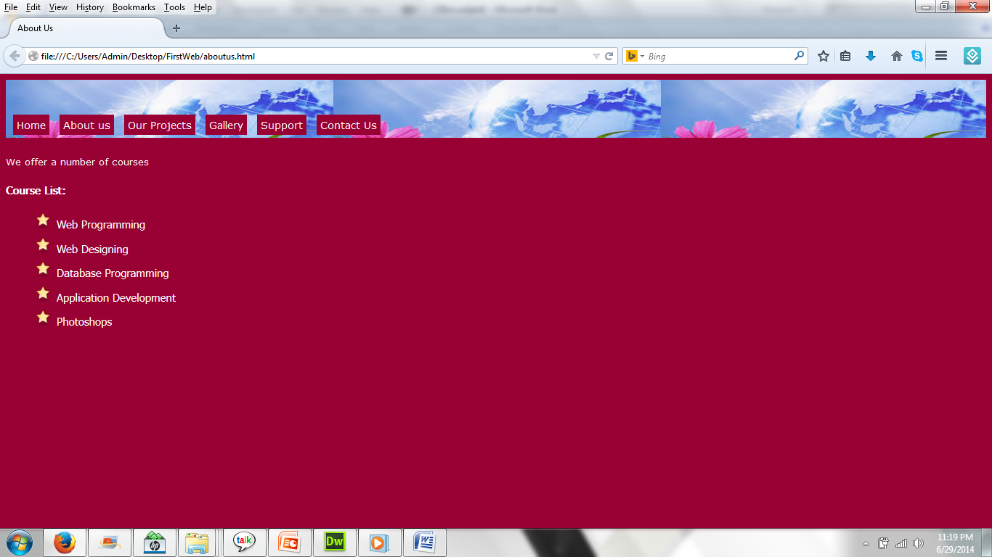
Lists with Images (CSS)

Slide 8
Lists with Bullets (CSS)
.lists
{ color:#FFF;
font-size:15px;
list-style-image:url(../images/star.png);
line-height:30px;
list-style-position: outside;
margin-left:30px;
}

Slide 9
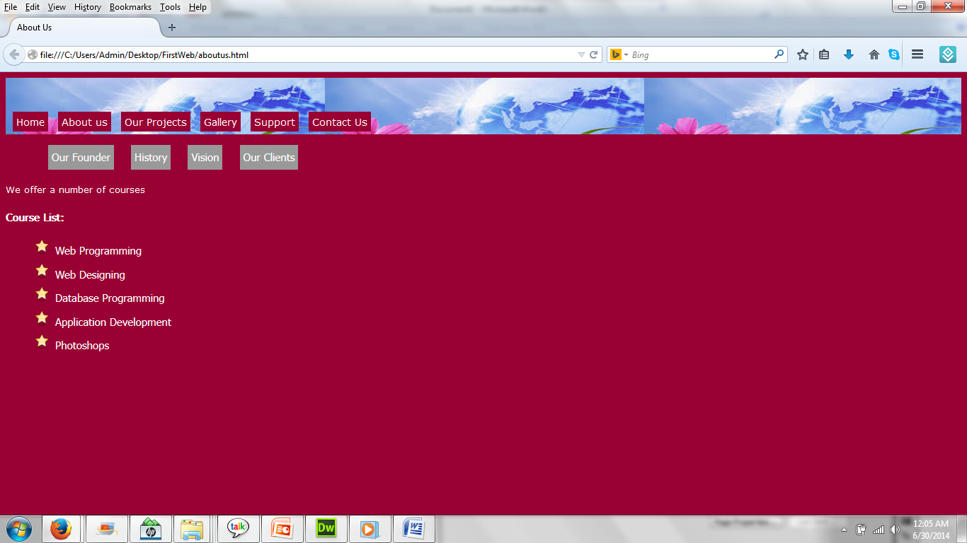
Lists with Submenu

Slide 10
Lists with Submenu (HTML)
<ul class="navlist">
<li><a href="">Our Founder</a></li>
<li><a href="">History</a></li>
<li><a href="">Vision</a></li>
<li><a href="">Our Clients</a></li>
</ul>

Slide 11
Lists with Submenu(CSS)
.navlist
{margin-top:20px;}
.navlist li
{display:inline;
margin-left:20px;}
.navlist li a
{color:#FFF;
font-size:15px;
padding:5px;
text-decoration:none;
background-color:#999;
}

Slide 12
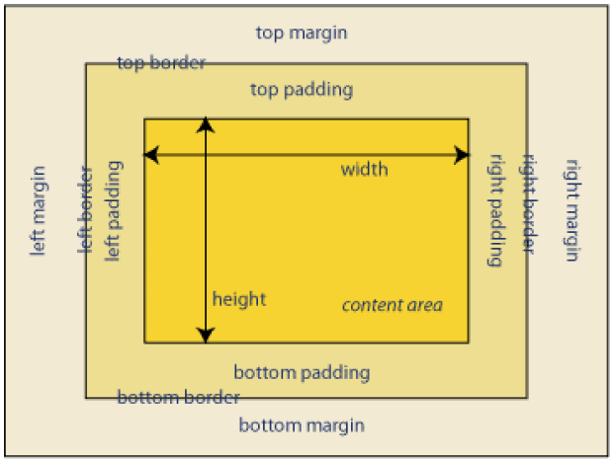
CSS Box Model

Slide 13
CSS Box Model
Margin - Clears an area around the border. The margin does not have a background color, it is completely transparent
Border - A border that goes around the padding and content. The border is inherited from the color property of the box
Padding - Clears an area around the content. The padding is affected by the background color of the box
Content - The content of the box, where text and images appear

Slide 14
CSS Box Model
The total width of an element should be calculated like this:
Total element width = width + left padding + right padding + left border + right border + left margin + right margin
The total height of an element should be calculated like this:
Total element height = height + top padding + bottom padding + top border + bottom border + top margin + bottom margin

Slide 15
CSS Margin and Padding
Clockwise values are given
Margin: top right bottom left;
Padding: top right bottom left;
Individual properties are also there.

Slide 16
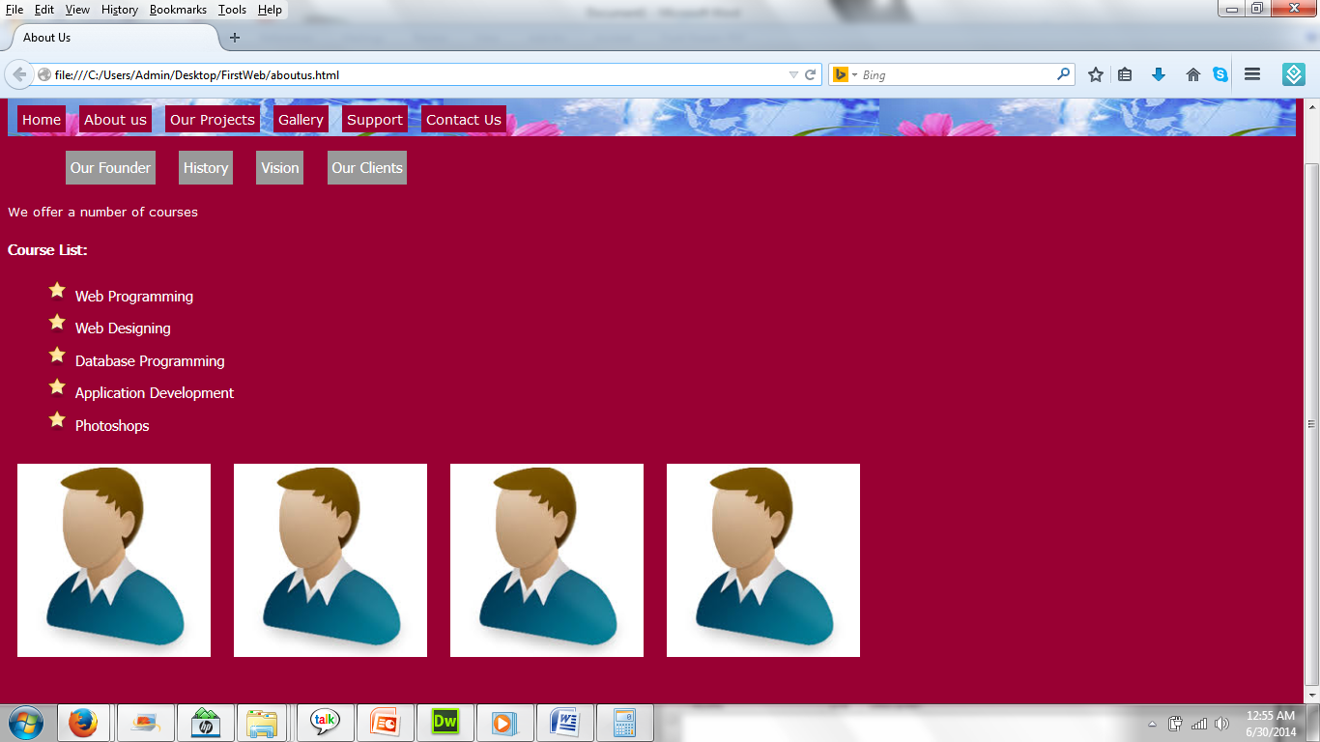
CSS Margin and Padding

Slide 17
CSS Margin and Padding (HTML)
<div class="persons">
<img width="200" src="images/person.jpg" alt="">
<img width="200" src="images/person.jpg" alt="">
<img width="200" src="images/person.jpg" alt="">
<img width="200" src="images/person.jpg" alt="">
</div>

Slide 18
CSS Margin and Padding (CSS)
.persons{
width:900px;
height:250px;
}
.persons img{
padding:10px;
}
Notes:
Remark: width=> 900 px,
image resolution => 256px*4 =1024
image width for each => 900/4=225px for each

Slide 19
CSS Float and clear
Floating an element makes it independent of other boxes
We can arrange multiple elements horizontally
Use clear property to clear any floats

Slide 20
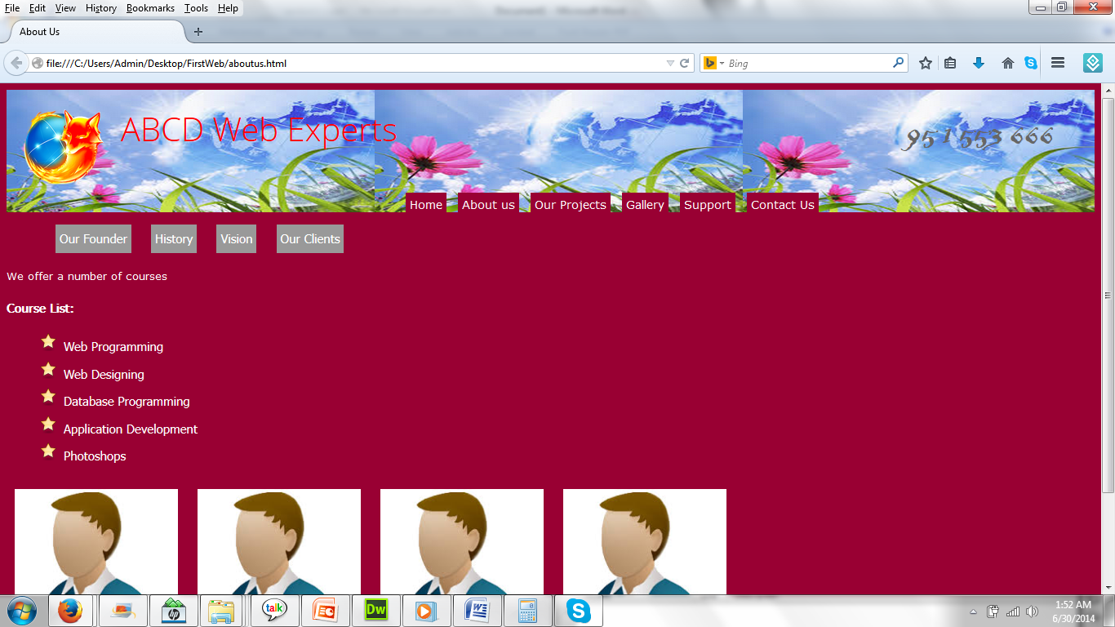
CSS Float and clear

Slide 21
CSS Float and clear (HTML)
<header>
<img class="logoimg" width="100" src="images/browser.png" alt="">
<h1 class="logo">ABCD Web Experts</h1>
<span class="phone">
95 1 553 666
</span>
<span class="clearFix"></span>
<nav id="mainNav">
……..
……..
</header>

Slide 22
CSS Float and clear(CSS)
.logo, .logoimg
{float:left;
margin:20px 0 0 20px;
}
.clearFix
{clear:both;
}
#mainNav
{margin-top:130px;
float:left;
}
.phone
{
float:right;
font-family:Blackadder;
font-size:50px;
color:#666;
margin:20px 50px 0 0;
}

Slide 23
CSS3 Opacity
Opacity is a property that can be applied to any element
Opacity is measured from 0 to 1
0 = totally transparent
1 = total opaque
0.5 = 50% transparent and so on….
Demo.

Slide 24
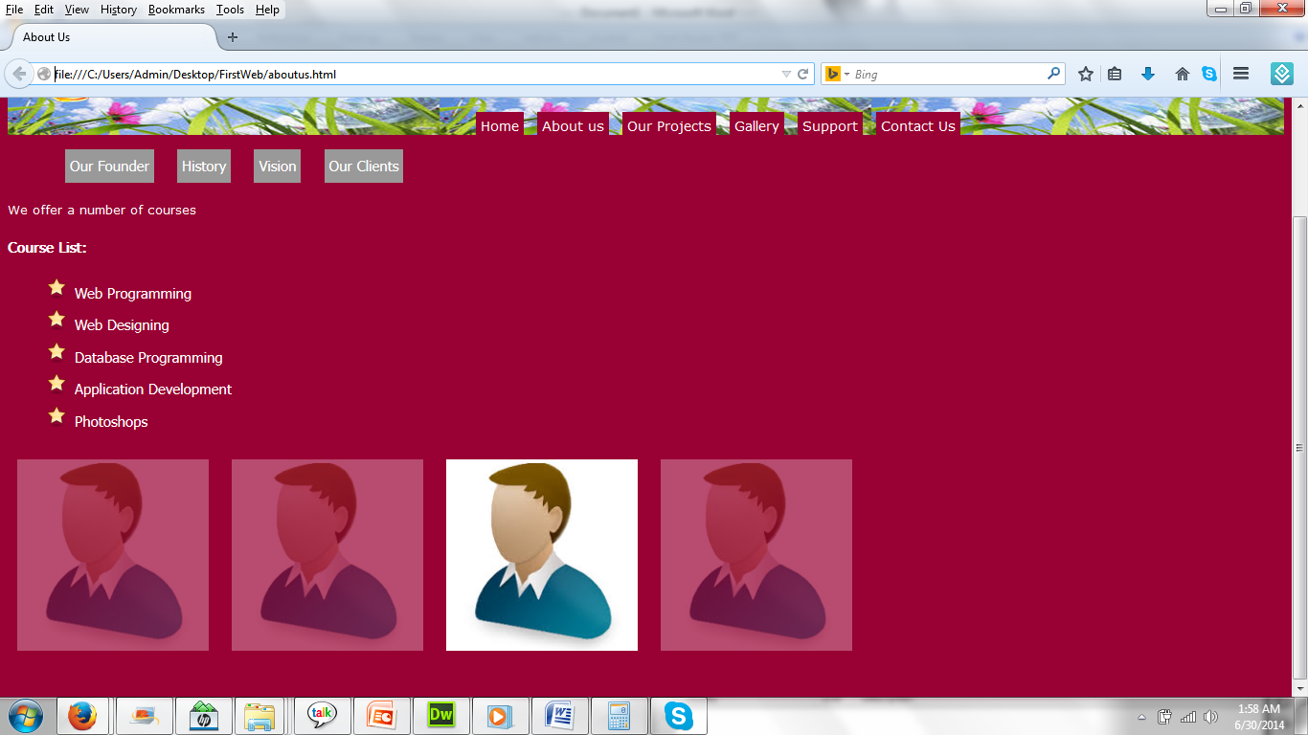
CSS3 Opacity

Slide 25
CSS3 Opacity(CSS)
.persons img{
padding:10px;
opacity:0.3;
}
.persons img:hover{
opacity:1;
cursor:pointer;
}

Slide 26
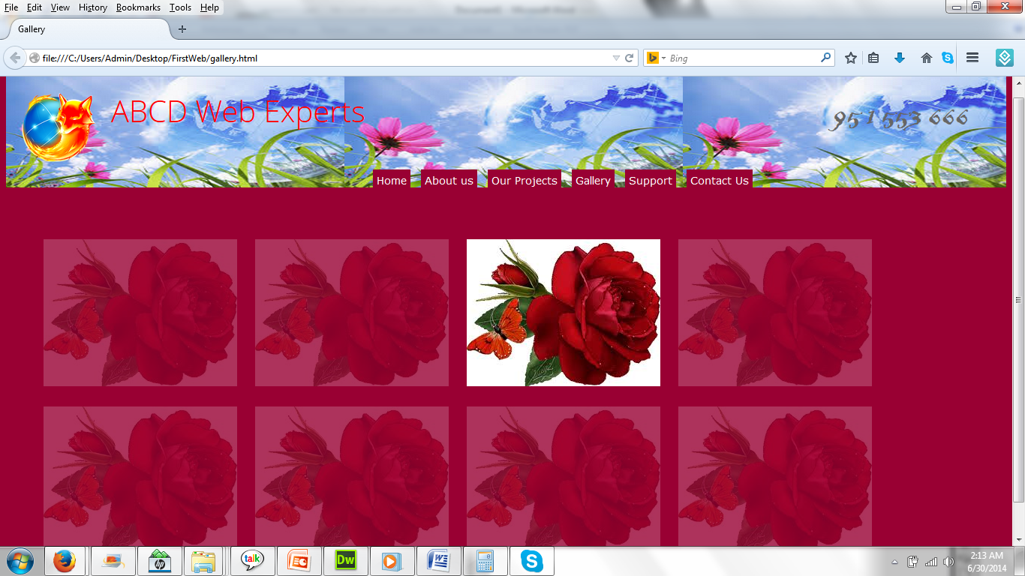
CSS3 Opacity

Slide 27
CSS3 Opacity(HTML)
<ul class="gallery">
<li><img src="images/Flower.jpg"></li>
<li><img src="images/Flower.jpg"></li>
<li><img src="images/Flower.jpg"></li>
<li><img src="images/Flower.jpg"></li>
<li><img src="images/Flower.jpg"></li>
<li><img src="images/Flower.jpg"></li>
<li><img src="images/Flower.jpg"></li>
<li><img src="images/Flower.jpg"></li>
</ul>

Slide 28
CSS3 Opacity(CSS)
.gallery
{list-style:none;}
.gallery li
{display:inline;}
.gallery li img
{ margin:10px;
opacity:0.2;
cursor:pointer;}
.gallery li img:hover
{opacity:1;}

Slide 29
CSS tables styling
HTML Tables look very simple
Styling them using CSS is logical
We should style tr, td and th individually
It is a mixture of using all selectors- elements, ID and class
Demo

Slide 30
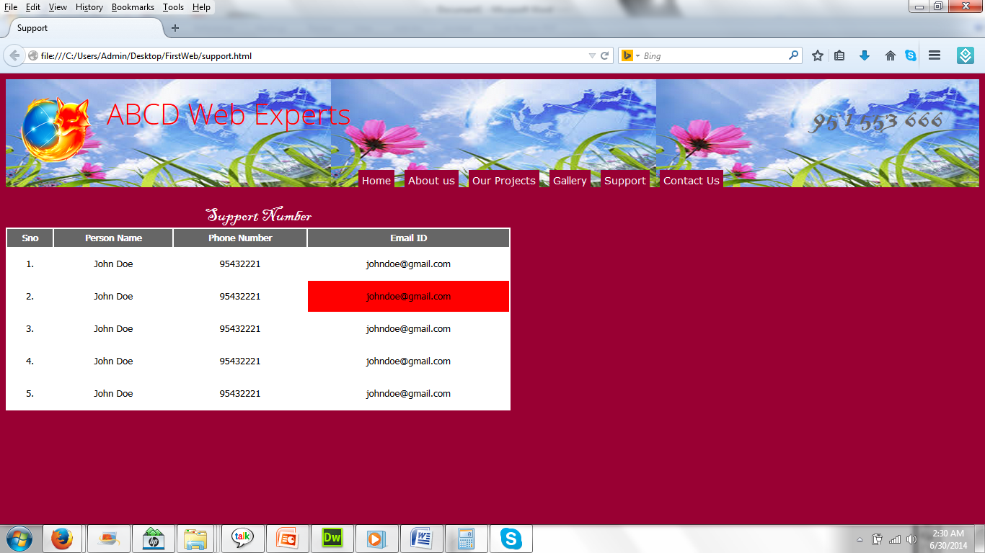
CSS tables styling

Slide 31
CSS tables styling(HTML)
<table class="support" align="left">
<caption>Support Number</caption>
<tr><th>Sno</th>
<th>Person Name</th>
<th>Phone Number</th>
<th>Email ID</th></tr>
<tr><td>1.</td>
<td>John Doe</td>
<td>95432221</td>
<td>johndoe@gmail.com</td>
</tr>
---
</table>

Slide 32
CSS tables styling(CSS)
.support
{width:700px;
background-color:#FFF;
margin:20px 0 0 0;}
.support caption
{font-family:Blackadder;
font-size:25px;
color:#FFF;}
.support th
{background-color:#666;
color:#FFF;}
.support td
{padding:10px;
text-align:center;
}
.support td:hover
{background-color:#F00;
}

Slide 33
CSS Image Gallery
Use of multiple styles
Float makes horizontal alignment
Opacity adds effects
Demo

Slide 34
Thank you!

